Slide 1
Environmental Impact Assessment EIA

Slide 2
Thought of the Day
The Living in the Moment Concept

Slide 3
DOMAINS OF ENVIRONMENT
Physical
• Air
• Water
• Land
Ecological
• Flora
• Fauna
Socio-economic
• Social
• Economic
• Cultural

Slide 4
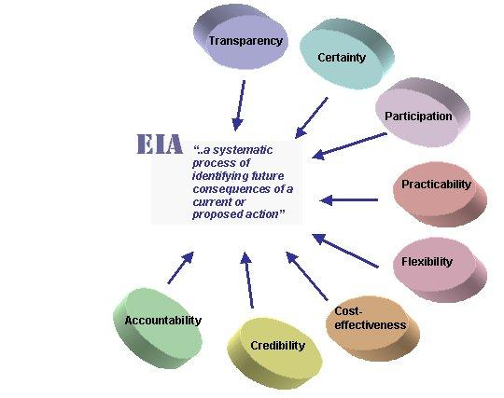
Environmental Impact Assessment EIA
WHAT IS EIA?
An important procedure for ensuring that the likely effects of new development on the environment are fully understood and taken into account before the development is allowed to go ahead

Slide 5
What EIA can do?
Modify and improve design
Ensure efficient resource use
Enhance social aspects
Identify measures for monitoring and managing impacts
Inform decision-making
Provide justification for a proposal

Slide 6
Origin of EIA in Pakistan
The EIA process was strengthened under Section 12 of Pakistan Environment Protection Act (PEPA), 1997
Guidelines were prepared with a thorough consultative process with the stakeholders
Initial Environmental Examination IEE/EIA Regulations, 2000 notified.

Slide 7
Pakistan Environmental Protection Act 1997
Penalties
Upto One Million Rupees (Rs 10,00,000) with a daily penalty of Rs 100,000
Environmental Tribunals
Judge
National Environmental Quality Standards (NEQS)
Arrest Warrants

Slide 8
List of Projects Requiring IEE/EIA
Agriculture, livestock and fisheries, etc.
Energy
Manufacturing and processing
Mining and mineral processing
Transport
Water management, dams, irrigation and flood protection
Waste Disposal
Urban development and tourism
Environmentally sensitive areas

Slide 9
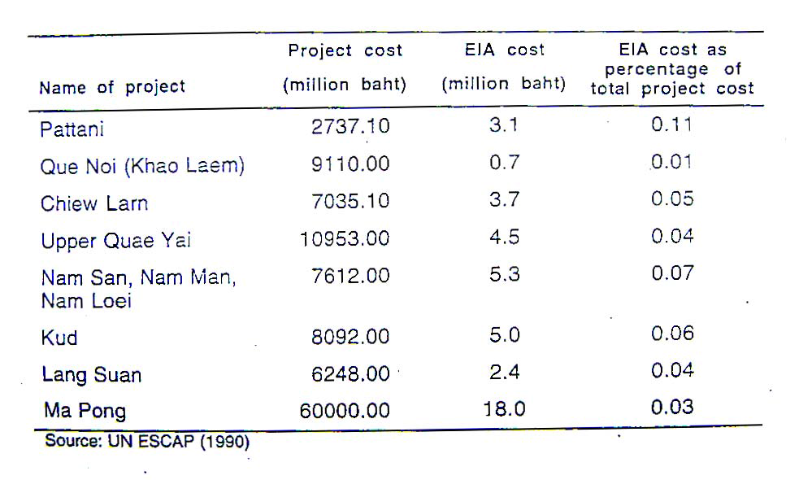
FINANCIAL ASPECTS OF EIA

Slide 10
Description of a Project
Type of project
Need for project
Location (use maps showing general location, specific location, project boundary and project site layout)
Size or magnitude of operation including any associated activities required by or for the project
Proposed schedule for approval and implementation
Description of the project including drawings showing project layout, components of project, etc. This information should be of the same type and extent as is included in feasibility reports for proposed projects, in order to give a clear picture of the project and its operations.

Slide 11
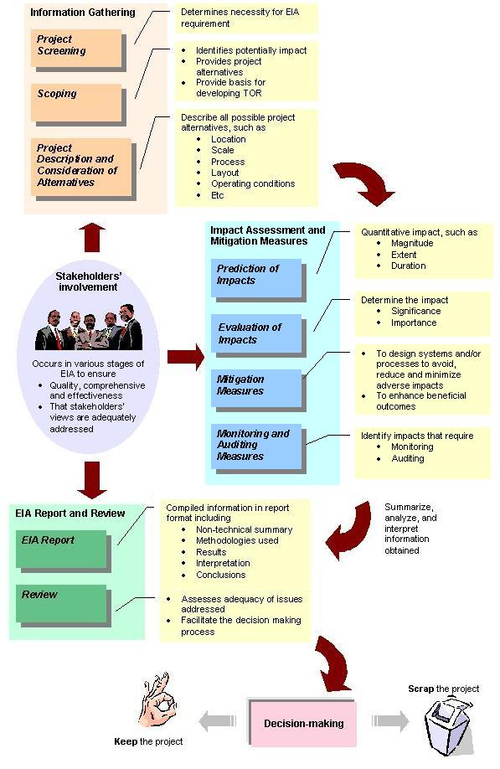
EIA processes in sequences of application
Project Screening
Scoping
Baseline Data Collection
Identification of Environmental Impacts
Impact Prediction Comparison of Alternatives
Comparison of Alternatives
Mitigation Measures
Public Consultation and Participation
Environmental Monitoring
Environmental Auditing

Slide 12
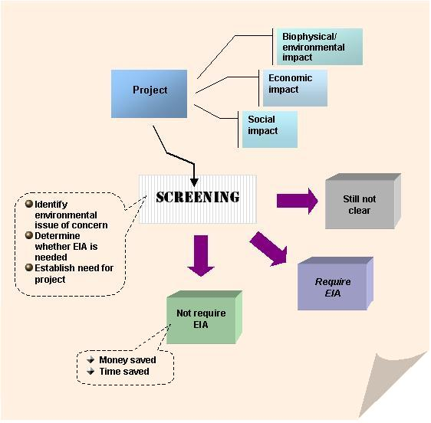
Screening
important to establish mechanisms by identifying projects which requires EIA, and this process of selection of project is referred to as "Screening“

Slide 13
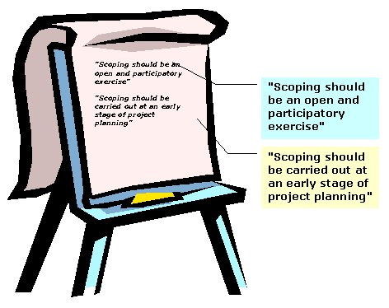
Project Scoping
Scoping is to determine what should be the coverage or scope of the EIA study for a project proposal as having potentially significant environmental impacts.

Slide 14
Baseline Data Collection
Baseline information is important reference point for conducting EIA.
The term "baseline" refers to the collection of background information on the biophysical, social and economic settings proposed project area.
Baseline data are collected for two main purposes:
to provide a description of the status and trends of environmental factors (e.g., air pollutant concentrations) against which predicted changes can be compared and evaluated in terms of importance, and
to provide a means of detecting actual change by monitoring once a project has been initiated

Slide 15
Identification of Environmental Impacts
Biological and Physio-chemical Impacts
Social Impact
demographic impacts, socio-economic impacts, institutional impacts, gender impact
Cultural Impacts
Health Impact
Economic Impact
labor force requirements, size of investment, likely demographic changes

Slide 16
Impact Prediction Comparison of Alternatives
Considerations for Impact Prediction
Magnitude of Impact
Extent of Impact
Duration of Impact
Uncertainty in Impact Prediction

Slide 17
Comparison of Alternatives
Qualitative approach
Quantitative approach
Ranking, rating or scaling approach
Weighting approach
Weighting-ranking/rating/scaling approach

Slide 18
ANALYSIS OF ALTERNATIVES
No Project Option
Location/Alignment Alternatives
Process/Design Alternatives
Demand/Activity Alternatives
Scheduling Alternatives
Input Alternatives

Slide 19
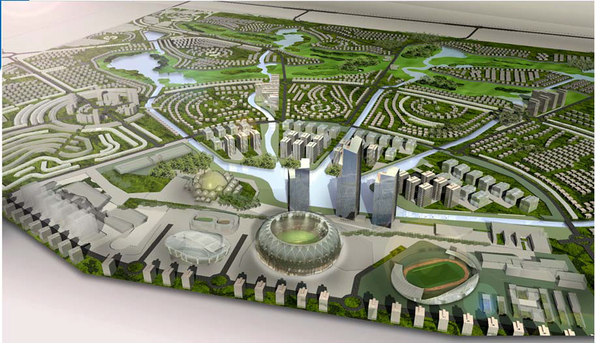
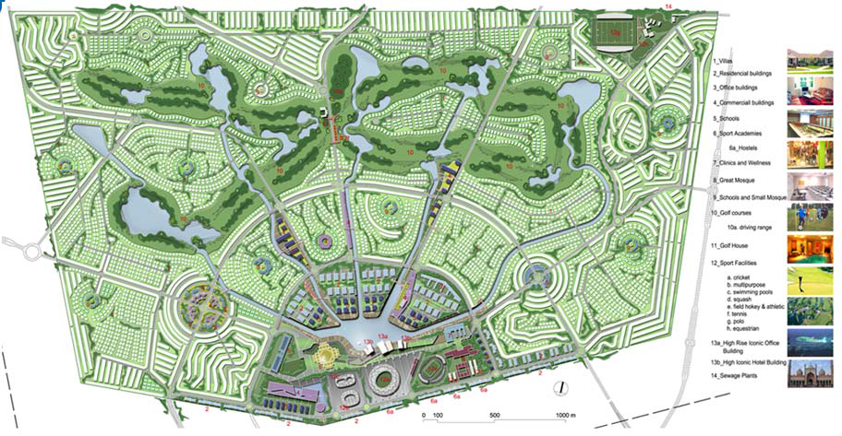
Lahore Sports City

Slide 20
Lahore Sports City (Site Screening Criteria)
Accessibility
Land use and Land availability
Aesthetics
Water Availability
Potential of Infrastructure Development
Environmental and Social Issues

Slide 21
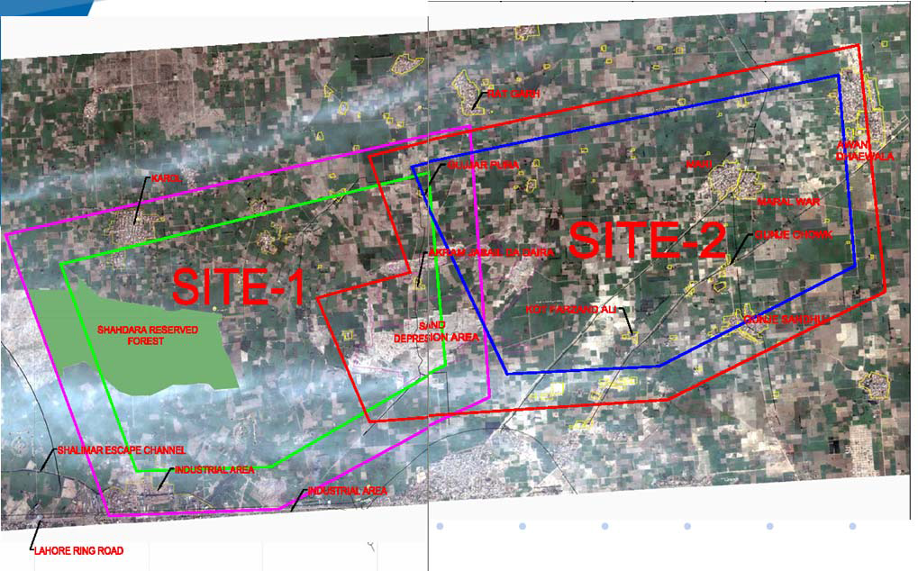
Site Options

Slide 22
Key elements for assessing impact significance
Ecological
effects on plant and animal habitat
rare and endangered species
ecosystem resilience, sensitivity, bio-diversity and carrying capacity
viability of local species populations
Environmental Standards
Social and Economical
effects on human health and safety
potential loss of species with current or potential value, or commercially available production (farmland)
recreational or aesthetic value
demands on public resources such as social service
demands on transportation and other infrastructures
demographic effects

Slide 23
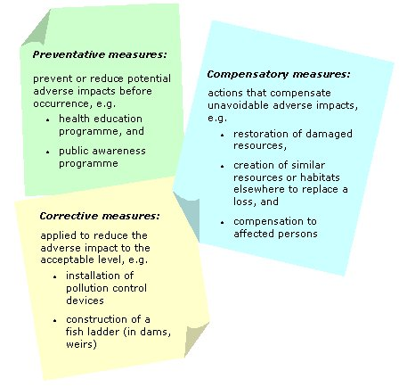
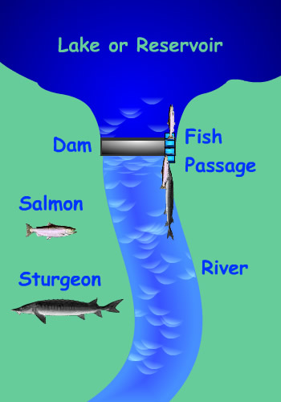
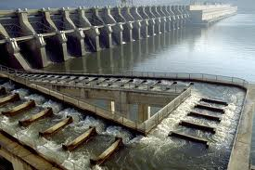
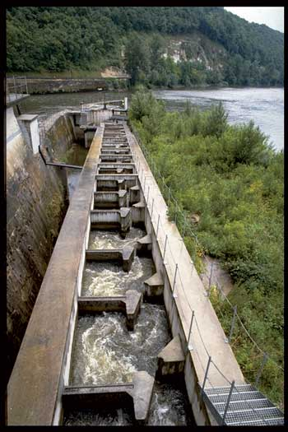
Mitigation Measures
recommended actions to reduce, avoid or offset the potential adverse environmental consequences of development activities
maximize project benefits
minimize undesirable impacts

Slide 24
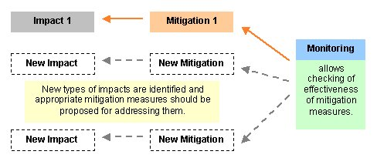
Mitigation Measures
Mitigation measures requires funding
Mitigation measures should be integrated in the project design
Mitigation measures is not limited to one point in the EIA process
Link between mitigation and monitoring

Slide 25
Public Consultation and Participation
Local people
Project beneficiaries
NGOs
Voluntary organizations
Private sector
National/local governments
Scientist/experts
Private sector

Slide 26
Methods for stakeholder involvement
Public meetings
Advisory panels
Public information centers
Interviews
Questionnaires
Participatory Appraisal techniques

Slide 27
Environmental Monitoring
an activity undertaken to provide specific information on the characteristics and functions of environmental and social variables in space and time
Environmental monitoring is therefore one of the most important components of an EIA
ensuring that impacts do not exceed the legal standards
checking the implementation of mitigation measures in the manner described in the EIA report
providing early warning of potential environmental damages

Slide 28
Principles of Monitoring
Determine the indicators to be used in monitoring activities
Collection of meaningful and relevant information
Application of measurable criteria in relation to chosen indicators
Reviewing objective judgments on the information collected
Draw tangible conclusions based on the processing of information
Making rational decision based on the conclusion drawn
Recommendation of improved mitigation measures to be undertaken

Slide 29
Types of Monitoring
Baseline Monitoring
pre-audit study
Impact Monitoring
Compliance Monitoring

Slide 30
Environmental Auditing
an audit assess the actual environmental impact
the accuracy of prediction
the effectiveness of environmental impact mitigation
enhancement measures
the functioning of monitoring mechanisms

Slide 31
Types of Audit
Decision Point Audit
Implementation Audit
Performance Audit
Project Impact Audit
Predictive Technique Audit
EIA Procedures Audit

Slide 32
Environmental Auditing Plan
condition of natural/social/economical resources prior to project implementation
mitigation measures implemented are effective to control adverse impact
degraded landscape have been restored into original condition
effect on the local economy of project implementation

Slide 33
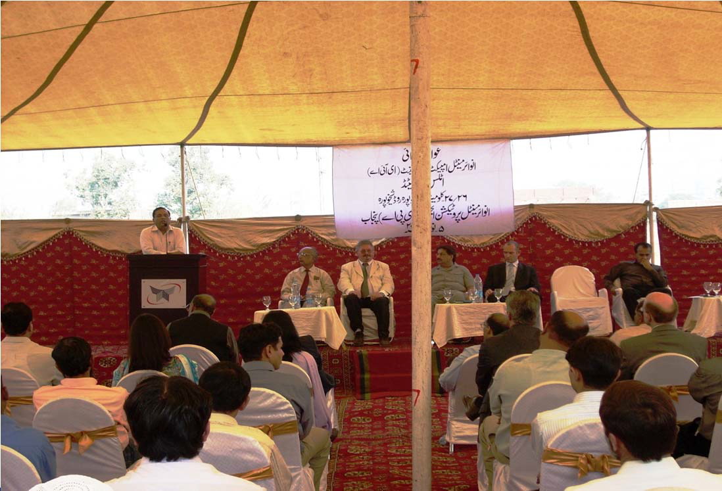
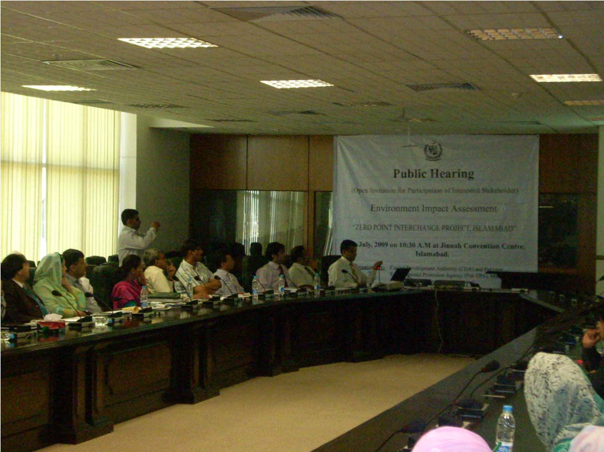
Public Hearing
Public Hearing of Environmental Impact Assessment of 225 MW Thermal Power RFO Fired Power Plant Near Sheikhupura
Public Hearing of Zero Point Interchange

Slide 34
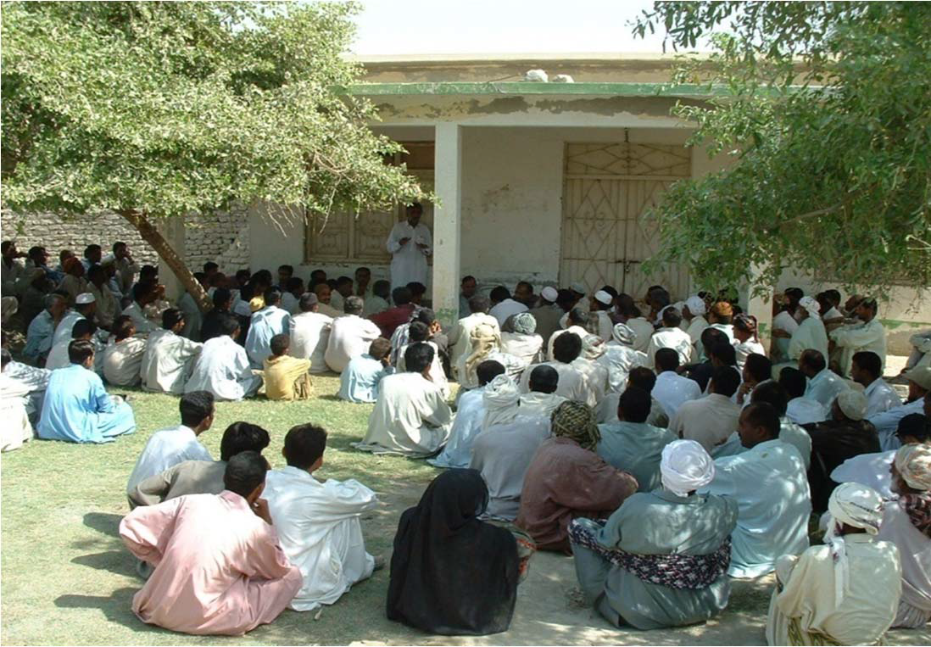
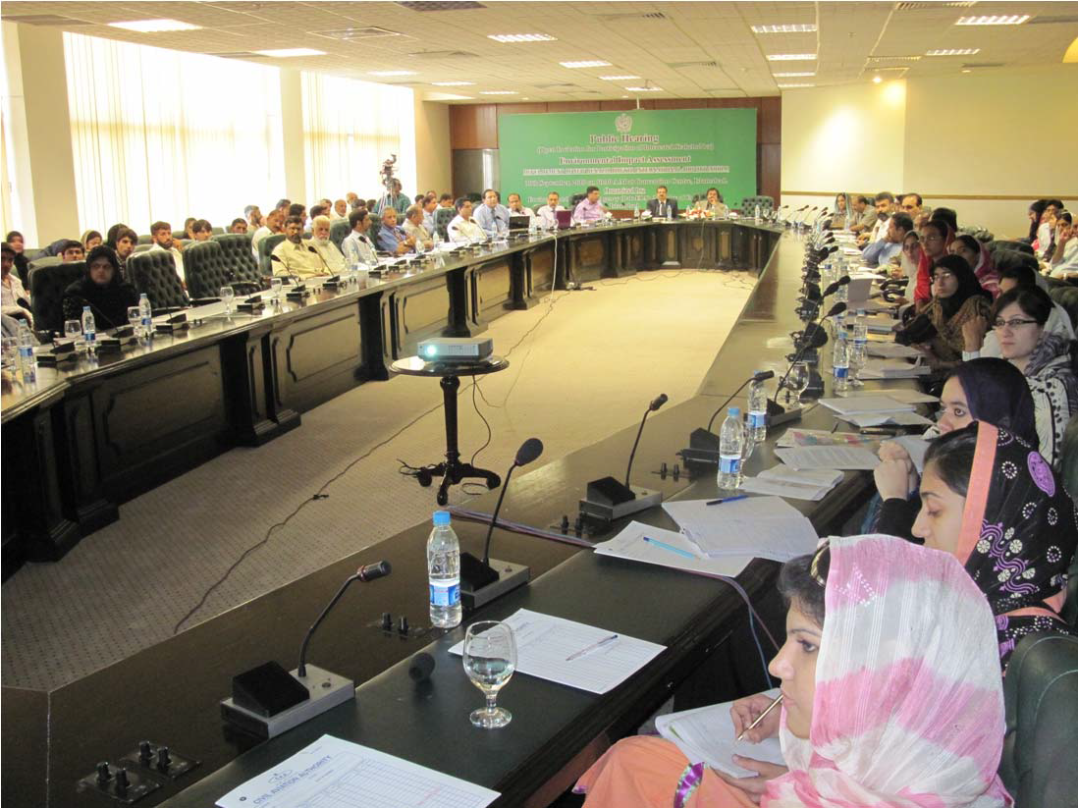
Public Hearing
Public Consultation for Mirani Dam Project
Public Hearing of Benazir Bhutto International Airport

Slide 35
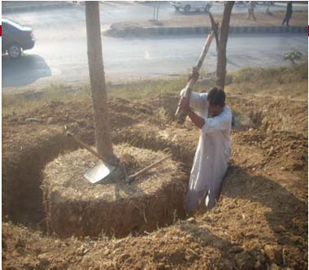
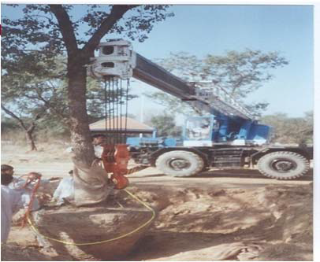
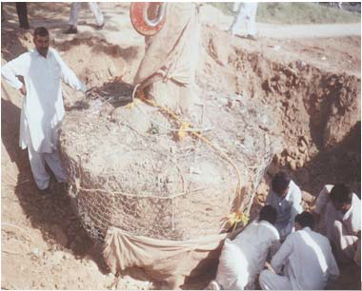
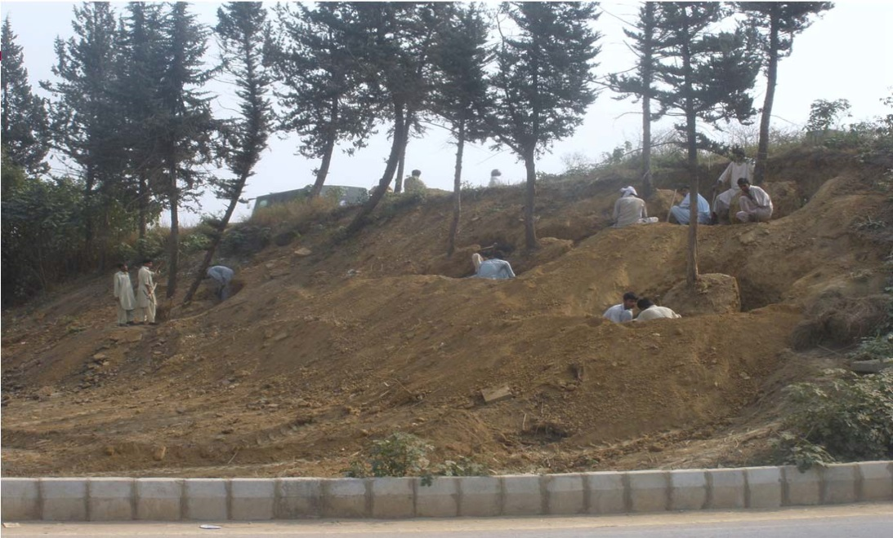
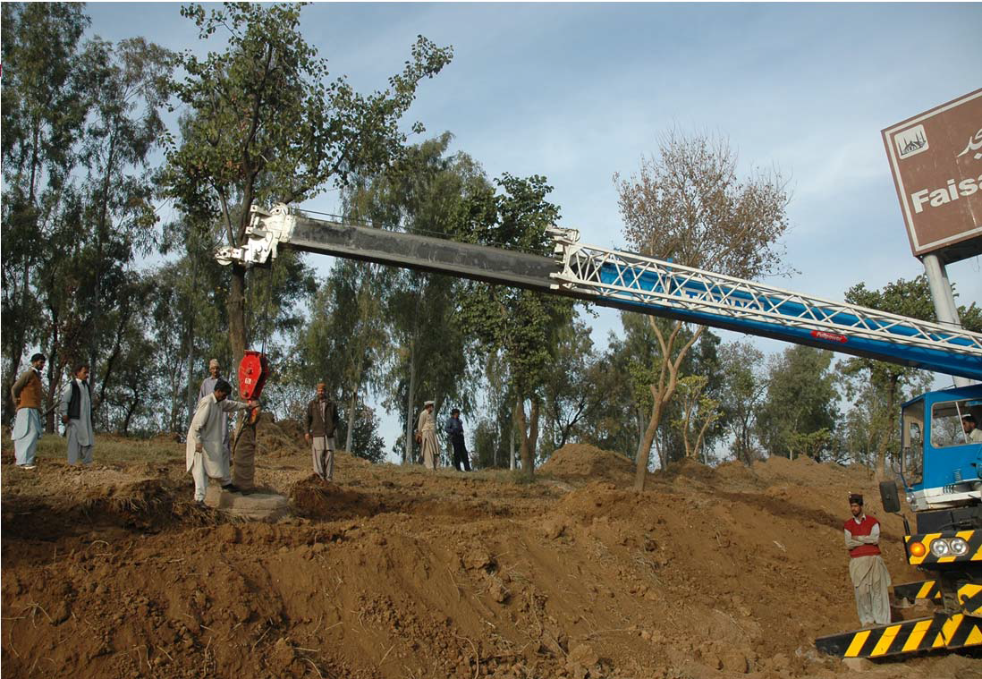
Transplantation of Trees

Slide 36
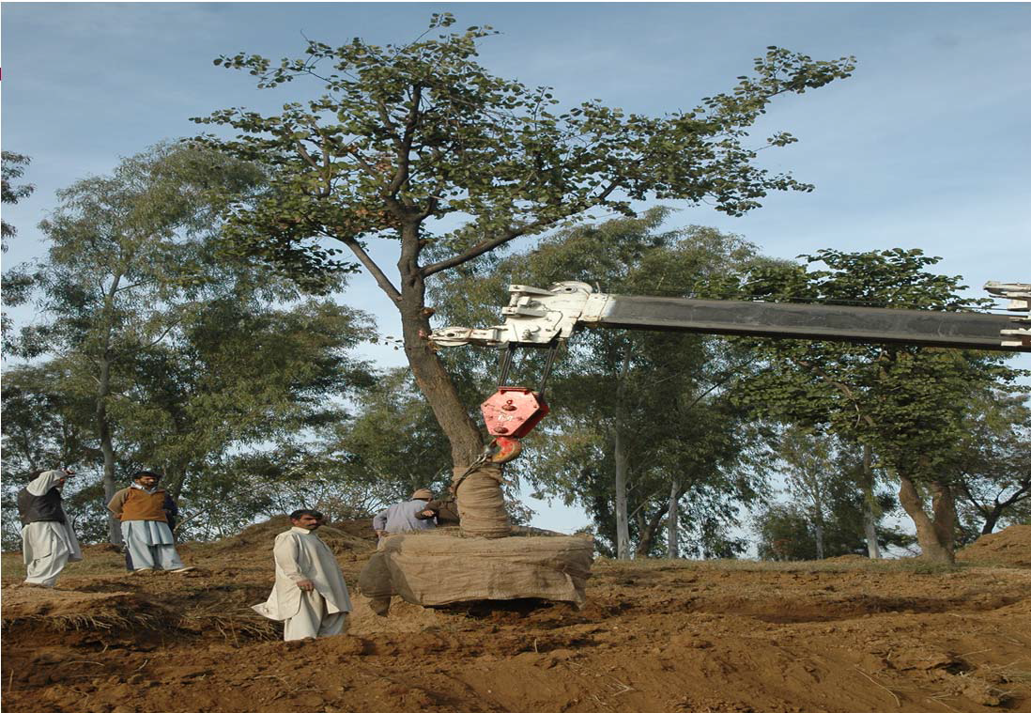
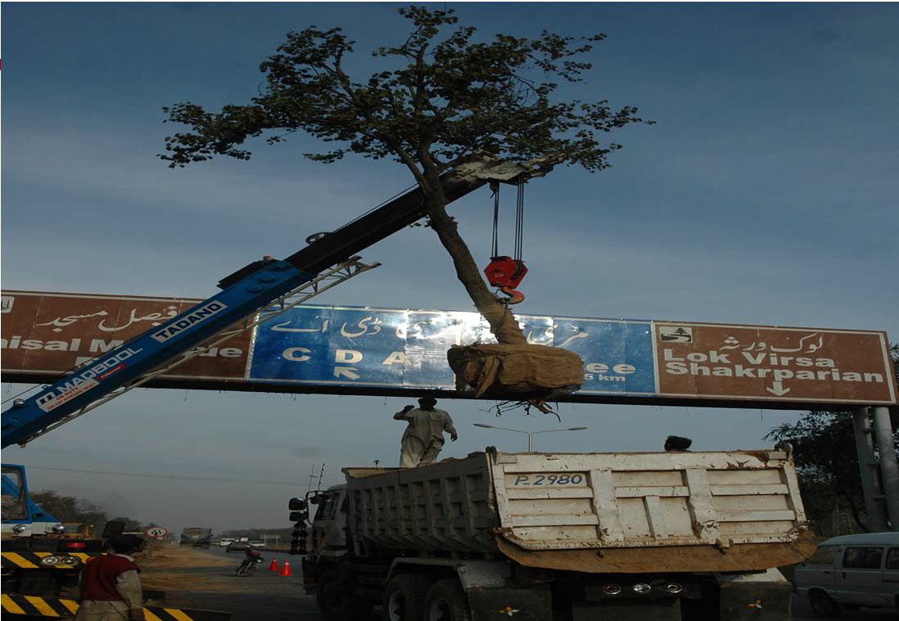
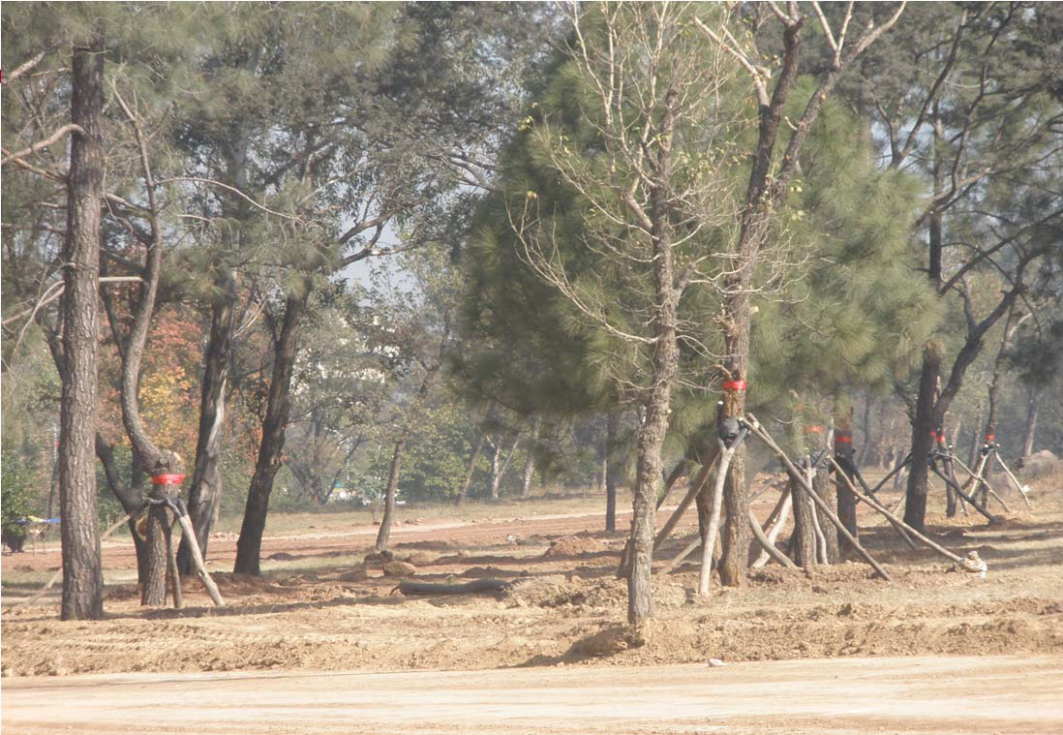
Transplantation of Trees

Slide 37
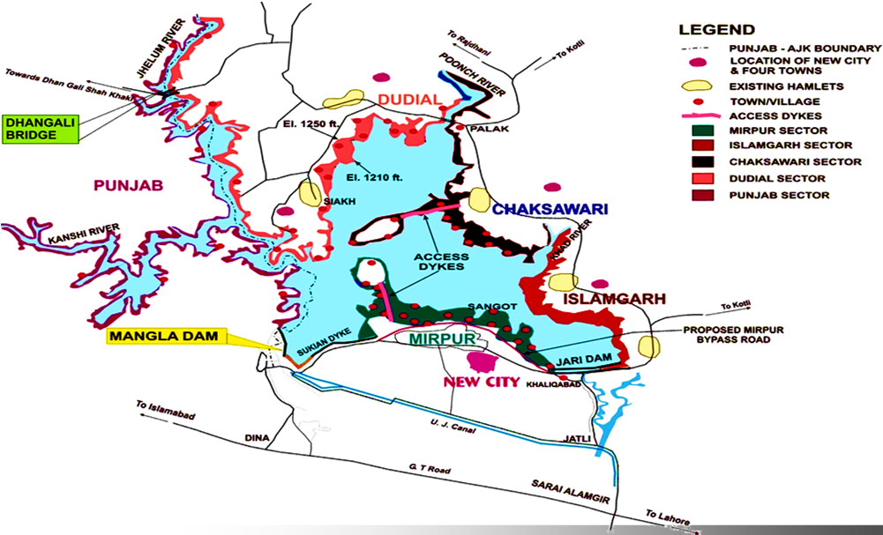
Mangla Dam Raising Project
A population of about 50,000 persons is being affected
About 8000 houses and other buildings are being affected
A total of 6,388 hectares of land (residential, agriculture and barren) is to be acquired
28 brick kilns will be abandoned
An unprecedented and very attractive compensation package for the affectees has been provided
Pakistan Resettlement Policy is being followed for the resettlement and compensation process

Slide 38
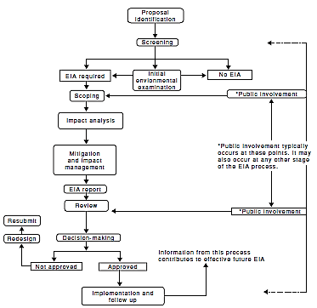
EIA Flow Chart

Slide 39
Strategic Environment Assessment SEA

Slide 40
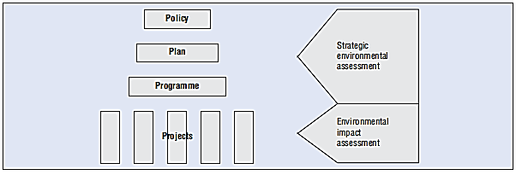
Strategic Environmental Assessment SEA
Social Impact Assessment (SIA)
Cumulative Impact Assessment (CIA)
Environmental and Social Impact Assessment (ESIA)

Slide 41
EIA | SEA
Applied to specific and relatively short-term (life-cycle) projects and their specifications | Applied to policies, plans and programs with broad, long-term strategic perspective
Takes place at early stage of project planning once parameters are set | Ideally, takes place at an early stage in strategic planning
Considers limited range of project alternatives | Considers a broad range of alternative scenarios
Usually prepared and/or funded by the project proponents | Conducted independently of any specific project proponent
Focus on obtaining project permission, and rarely with feedback to policy, plan or program consideration | Focus on decision on policy, plan and program implications for future lower-level decisions
Well-defined, linear process with clear beginning and end | Multi-stage, iterative process with feedback loops
Preparation of an EIA document with prescribed format and contents is usually mandatory. This document provides a baseline reference for monitoring | May not be formally documented
Limited review of cumulative impacts, often limited to phases of a specific project. Does not cover regional-scale developments or multiple projects | Inherently incorporates consideration of cumulative impacts

Slide 42
Tools for predicting environmental and socio-economic effects
Modeling or forecasting of direct environmental effects
Matrices and network analysis
Participatory or consultative techniques
Geographical information systems as a tool to analyze, organize and present information

Slide 43
Tools for analyzing and comparing options
Scenario analysis and multi-criteria analysis
Risk analysis or assessment
Cost benefit analysis
Opinion surveys to identify priorities

Slide 44
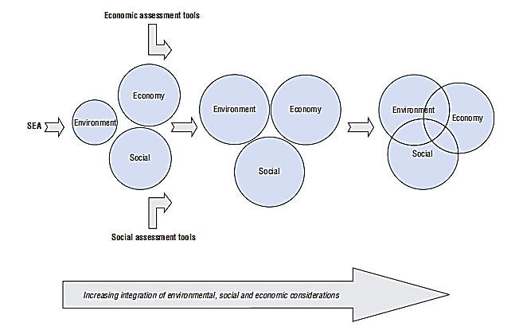
A continuum of SEA application

Slide 45
SEA benefits at a glance
Supporting the integration of environment and development
Providing environmental-based evidence to support informed decisions
Improving the identification of new opportunities
Preventing costly mistakes
Building public engagement in decision making for improved governance
Facilitating transboundary co-operation

Slide 46
Thermal Power Generation Policy, Pakistan: an early SEA would have helped
In the mid 1990s, rapidly expanding industrial activity, increasing population
Pakistan’s Government decided to stimulate increased power generation
Independent Power Plants Policy (IPPs) provided incentives for investments in thermal power generation
No SEA was made; instead investors had to submit an EIA without considering potential cumulative effects
Investors given freedom to choose the site, technology and the fuel
plants were installed with little or no pollution control devices
Leading energy experts and the WAPDA raised objections to the policy but were ignored
EIA used down-stream decision making approach
individual projects, especially after deciding the site, technology and fuel
thermal power stations using high-sulphur furnace oil became clustered in one city and added to the already polluted air
Alternatively, they were developed in a scattered way in remote places, which made it difficult to connect them with the national grid system
Key costs
Increased pollution
Relocation of plants – following public pressure and lobbying – at considerable cost
Delayed delivery of energy

Slide 47
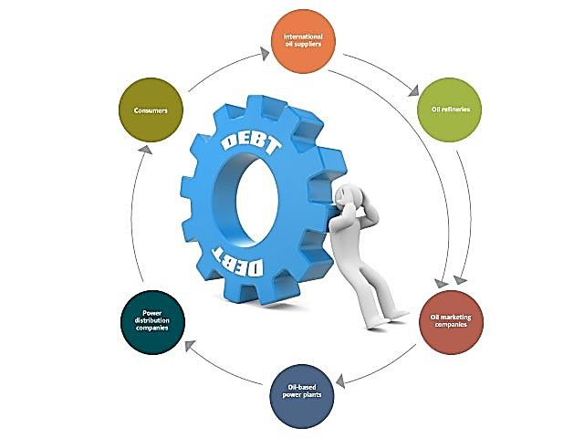
The Circular Debt of Pakistan
According to USAID report on the Causes and Impacts of Power Sector Circular Debt in Pakistan
in 2008, the circular debt was Rs 161.21 billion
increased to Rs 235.65 billion in 2009
circular debt in 2010 increased to Rs 365.66 billion
in 2011, this amount swelled to Rs 537.53 billion
During the current fiscal year circular debt increased to Rs 872.41 billion

Slide 48
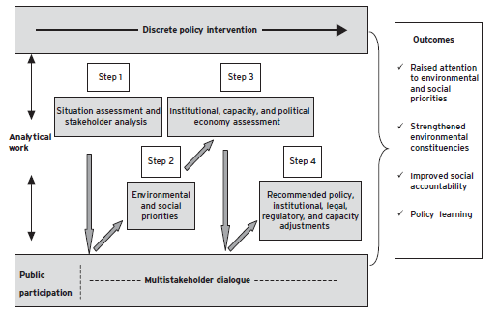
Policy SEA Process Steps

Slide 49
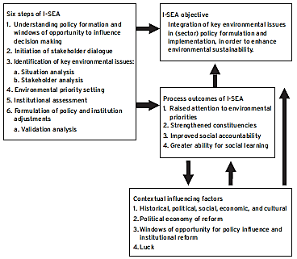
Conceptual Model of SEA

Slide 50
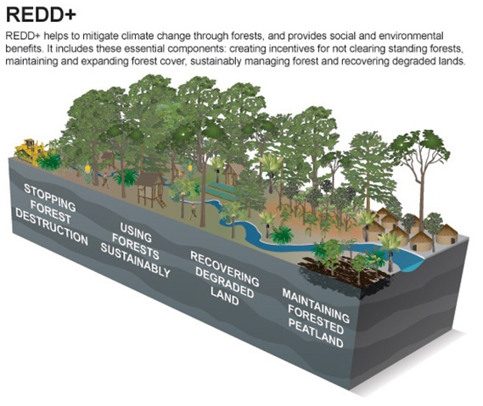
Reducing Emissions from Deforestation and Degradation (REDD+)

Slide 51
Thank You

